Slide 1

Facebook users
Profile Activities

Slide 2
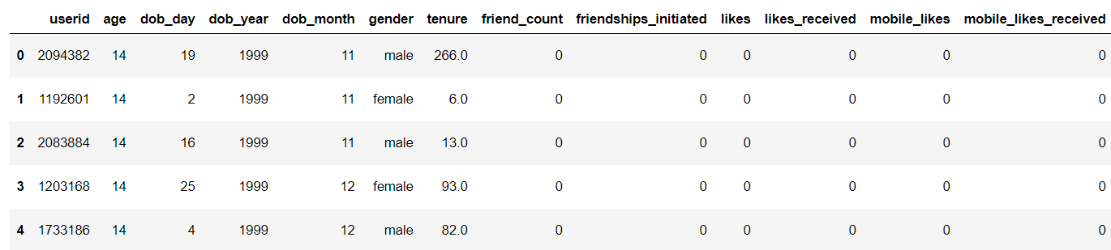
Facebook dataset:
Facebook dataset having user details with respect to their activities and profile nature.

Slide 3
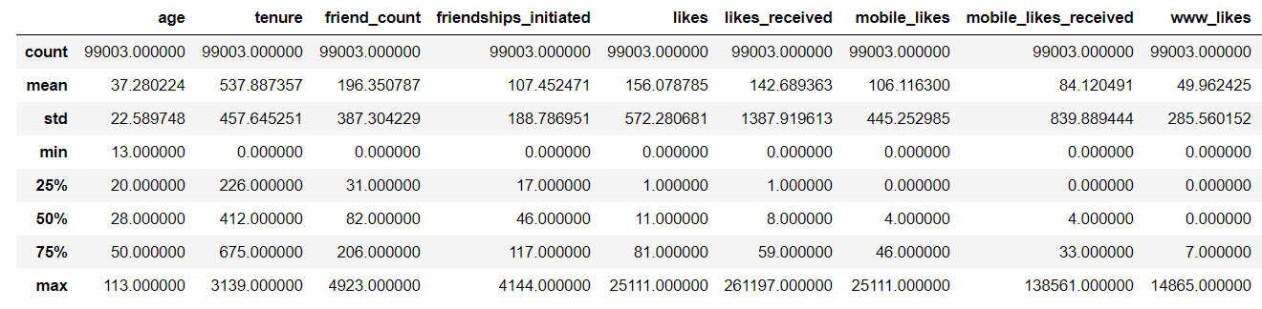
Dataset description:
It shows broad view of how data distributed in each aspect of attributes

Slide 4
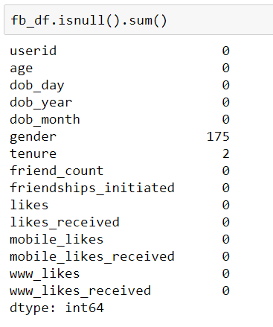
Dataset Preprofiling(Null values)
Dataset before cleaning, having 175 Gender and 2 tenure fields having Null values.

Slide 5
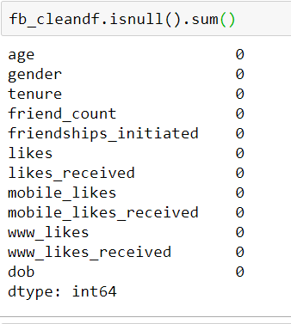
Dataset Post profiling:
After data cleaning activities i.e. replacing age null values with “not specified” text label and tenure value with mean of total tenure set.

Slide 6
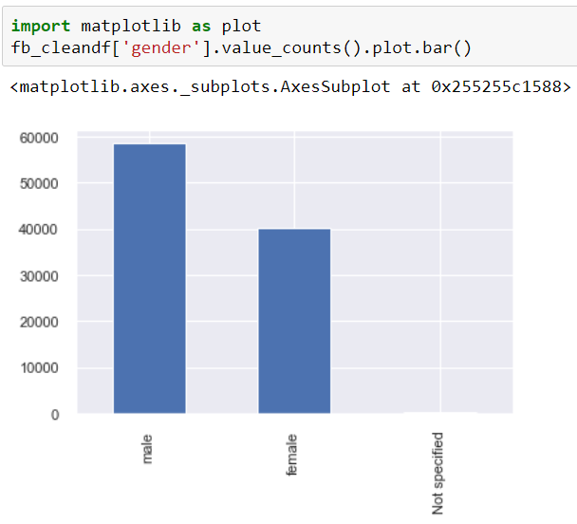
Male and Female distribution:
This plot shows gender distribution across total dataset.
Graph shows male count close to 59k.
And female count close to 40k.
“Not specified” are 175, very minimal.

Slide 7
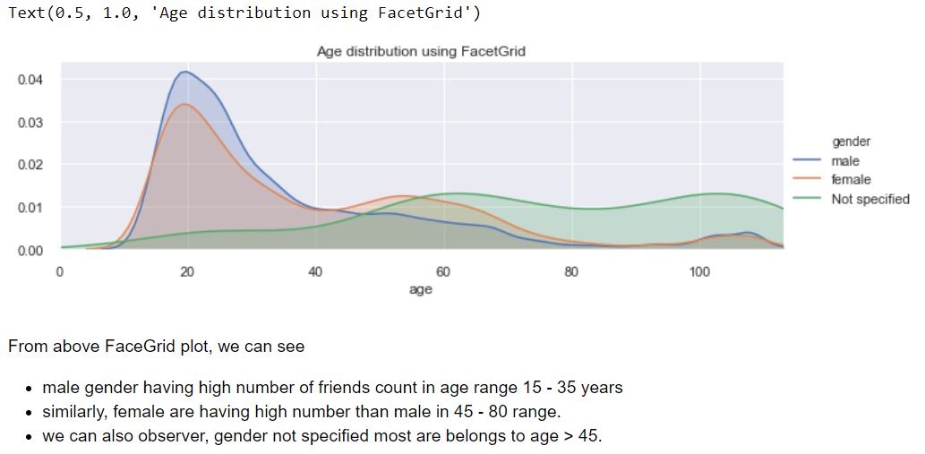
Gender Vs Age distribution:

Slide 8
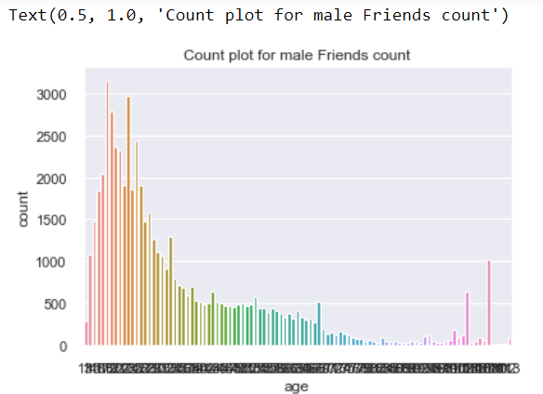
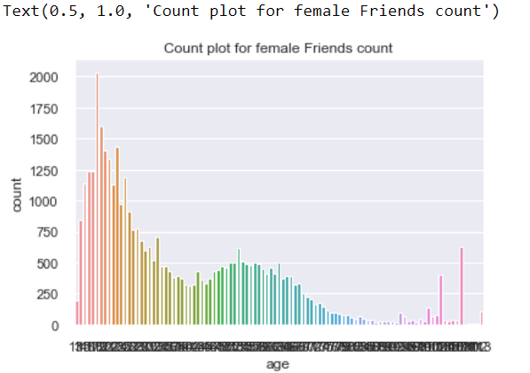
Friends count Vs Gender Vs Age: 1) From two graphs there is slight differences(in middle) between both genders friends count. 2) Male members are having high number of friends compares to female.

Slide 9
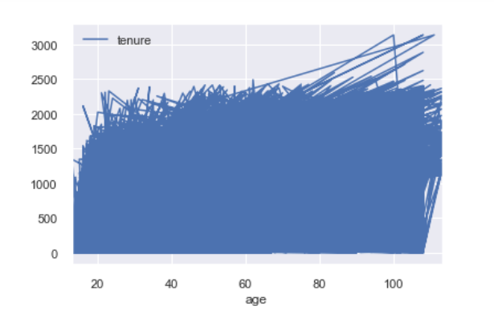
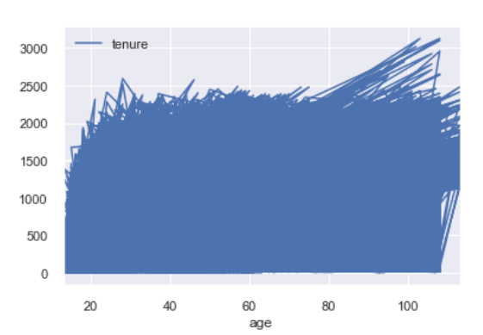
Gender Vs Age Vs Tenure:
From above graphs, we can see male users dominating slightly female, and both genders plot distrubution looking similar respect to age ranges.
Male tenure plot
Female tenure plot

Slide 10
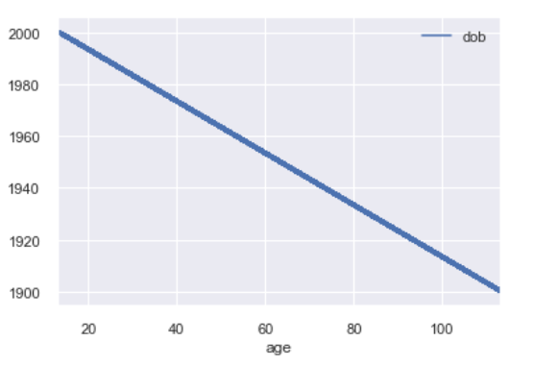
Users age distribution:
Here Users and age are inversely proportional.
Plot view:

Slide 11
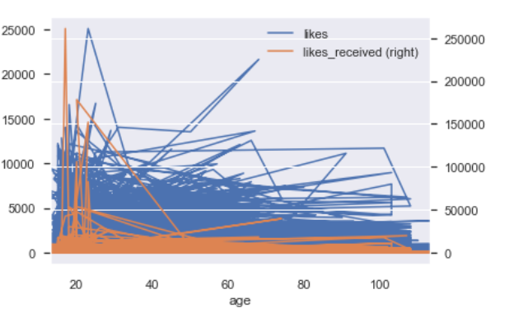
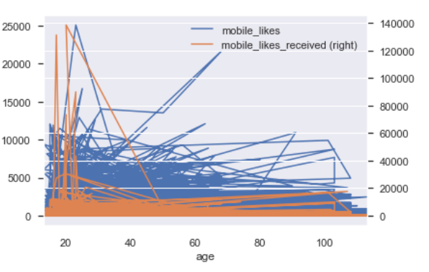
Likes ratio (plots)
Plots are looking almost same for all kinds of likes related fields. But through we can see more number of likes received than user likes.

Slide 12
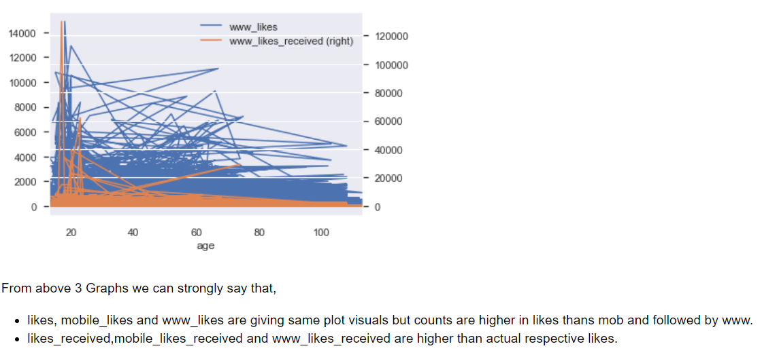
www_likes and received plot:

Slide 13
Conclusion:
Male users are more, compared with female users counts in all areas.
Gender "not specified" users are mostly falling under above age 45.
The likes ratio irrespective of mobile, www and likes are same between both genders. but likes received are different in each medium.
The tenure ration is bit higher for male than female.

